Slide 1

Study Abroad Info Session
Hosted by Erik Campuzano

Slide 2
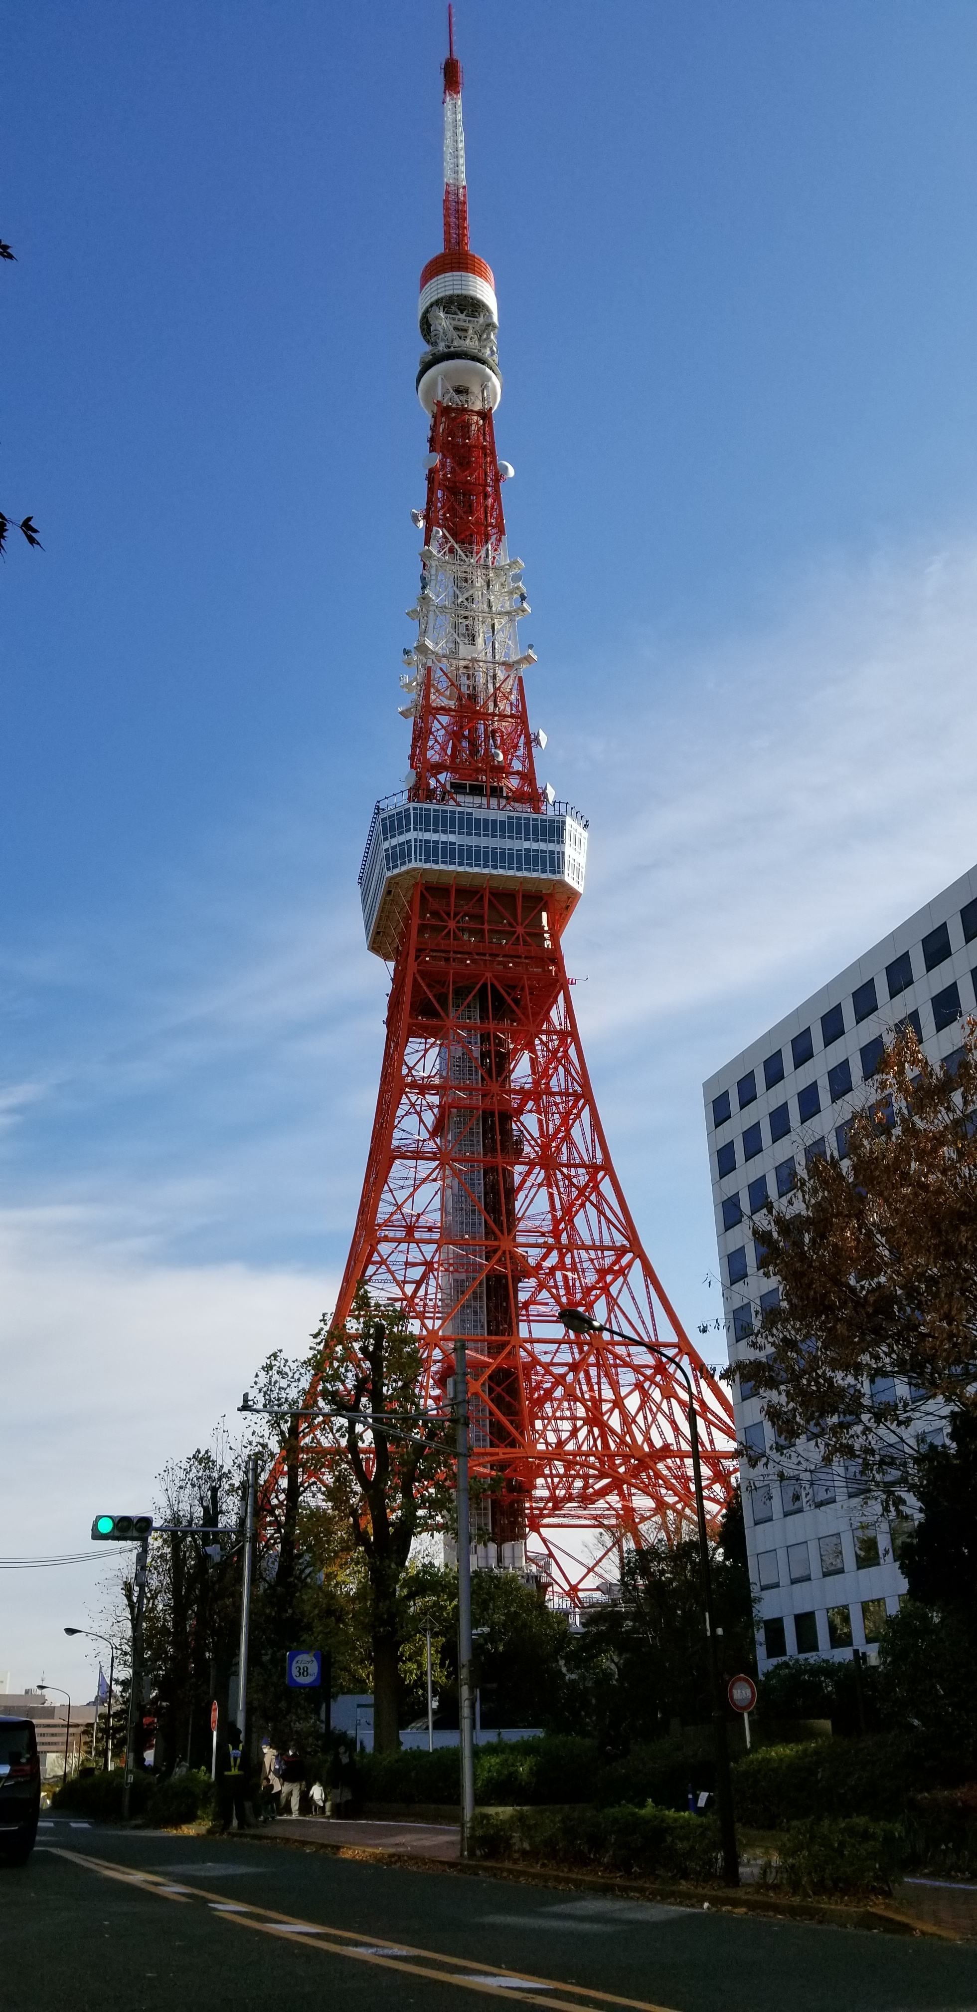
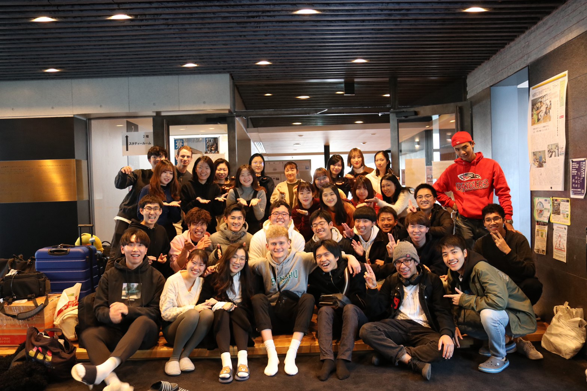
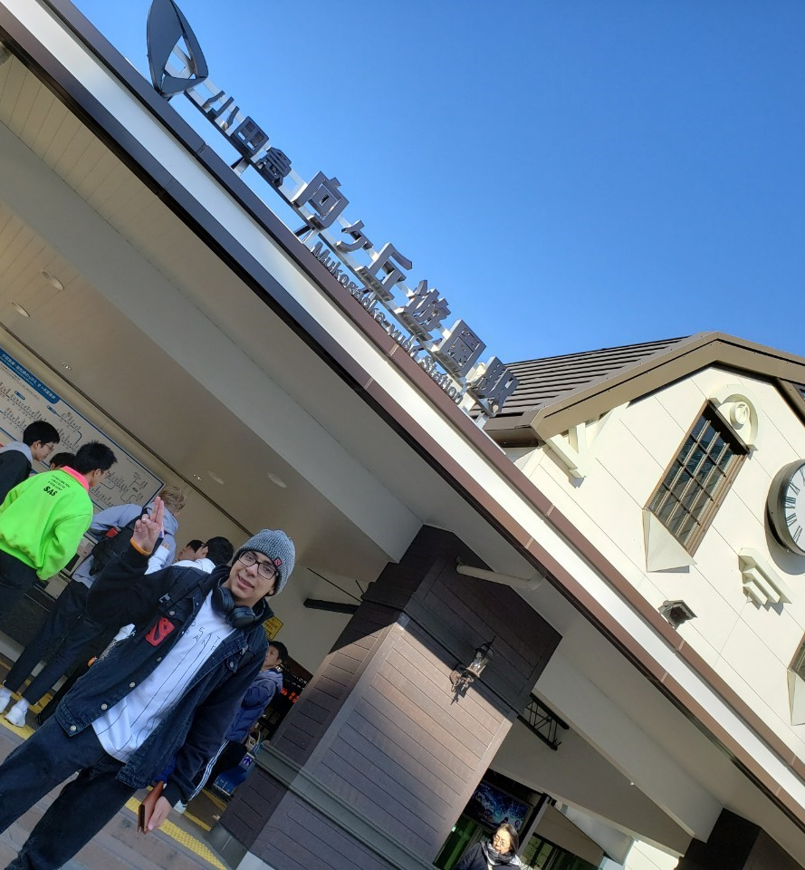
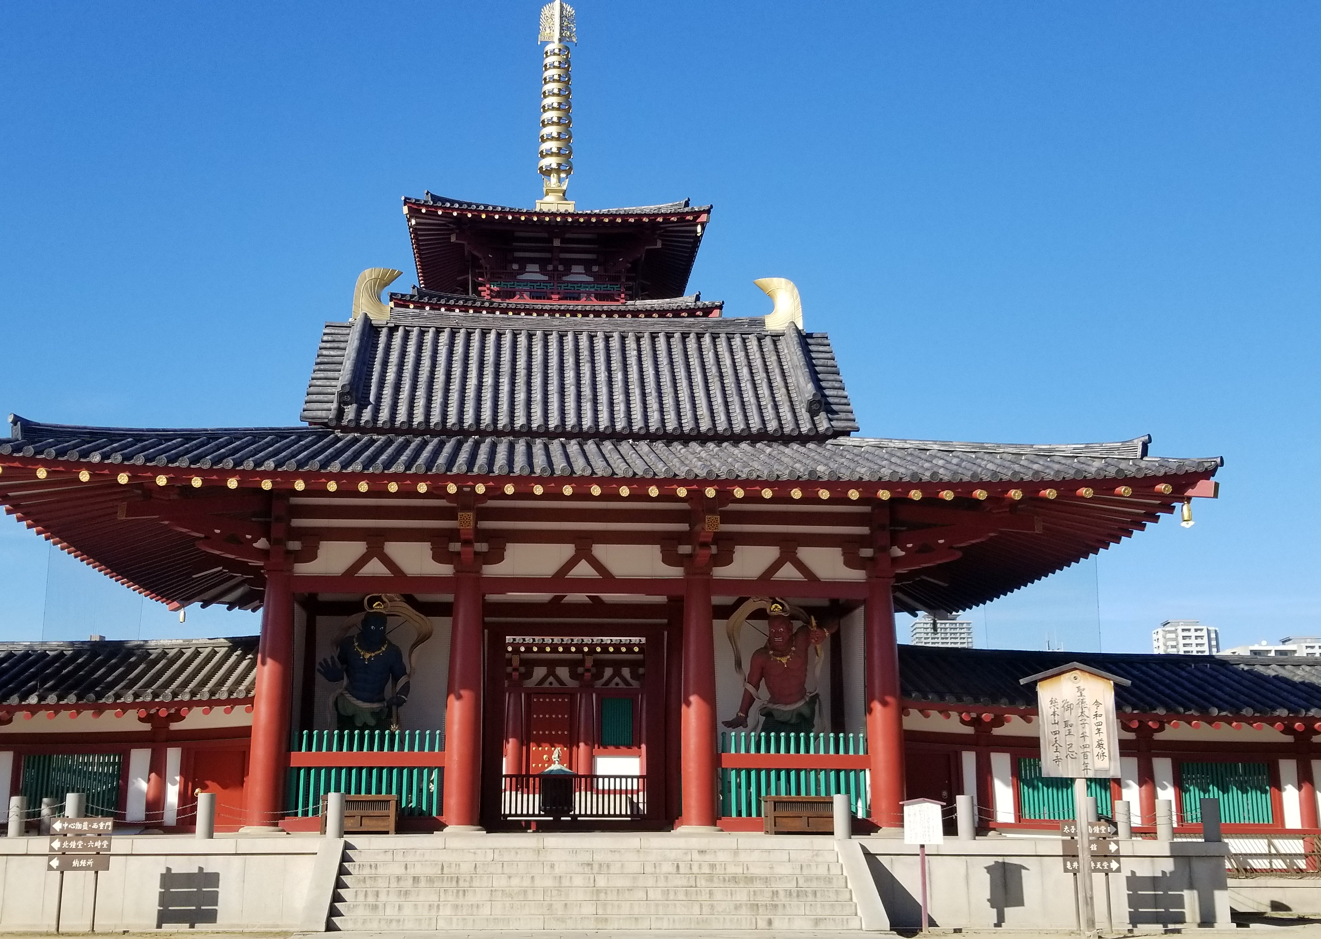
Study Abroad is a Great Opportunity.
You can learn so much from Study Abroad.

Slide 3



APPLY FOR SCHOLARSHIPS
Japan America Friendship Fund
Gilman Scholarship
Freeman-Asia Scholarship
Geo Scholarship

Slide 4
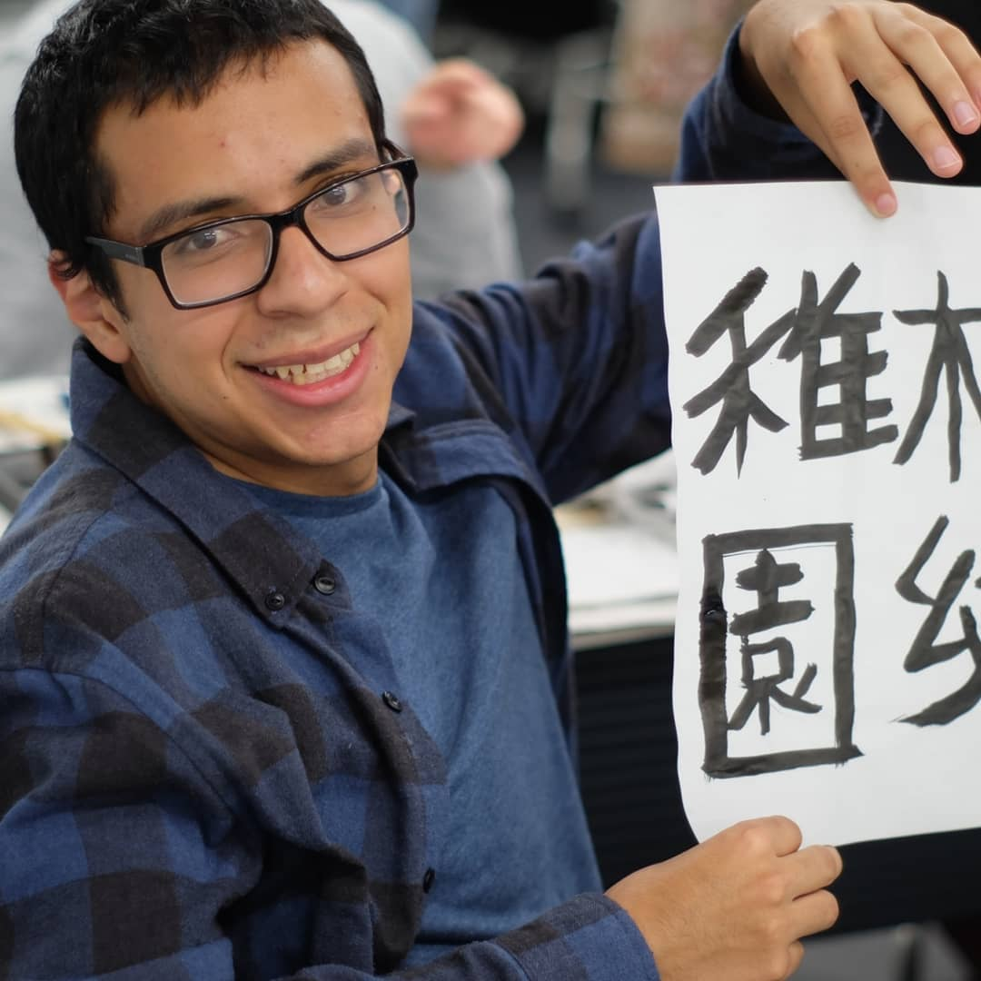
Last Things.
I know going abroad can be scary so I made a whole site dedicated to my experience.
japrgoesabroad.home.blog
Insert Time Here.

